Slide 1
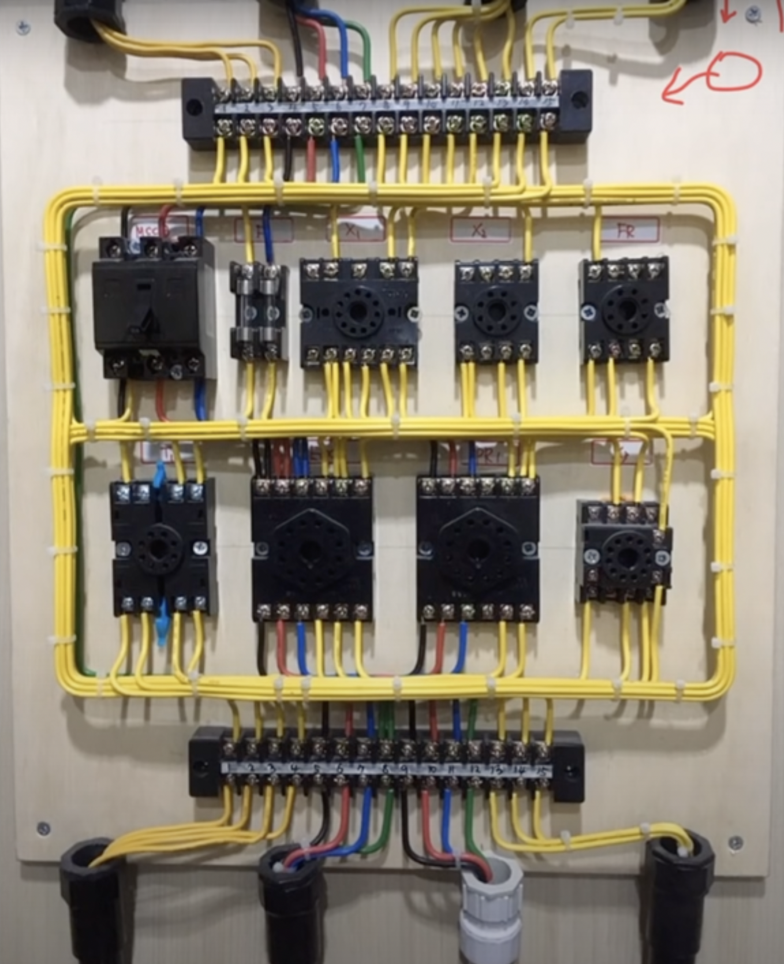
Notes:
Hello, my name is Ji-won ChungI am a sophomore in the Department of Electrical and Electronics at Seoul Technical High School.
Our department provides education and practice on electronic device control and manufacturing, automatic control equipment, and electrical wiring equipment maintenance and repair.

Slide 2
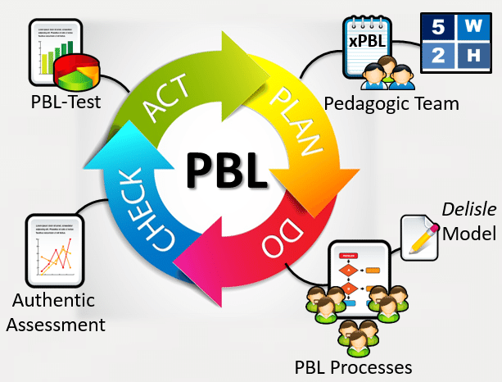
Notes:
In the second semester of the sophomore year, project classes are held, where students take the initiative to set up and carry out tasks and practice becoming a member of society.
I did it a while ago, and it was impressive.

